Slide 1


Online Religion: The Good, the Bad and the Ugly
Terry Anderson
NAUA Summit
October 2026

Slide 2
Overview
Good
Bad
Ugly
Research on Online religious practices
How can our liberal online religion be improved?
Examples of online religious practices

Slide 3

The Pandemic
Notes:
I went on line in 1981 45 years ago

Slide 4

The Pandemic
Off line Church participation dropped to zero.
Large majority of Unitarians very quickly adapted to Internet media. Most everyone gained Zoom competence
After pandemic, some recovery off-line, never reaching 2020 figures
Many churches continue to broadcast and hold church business online
Some churches continue to have dynamic and growing online congregations
“innovations imagined and conceived as temporary have generated regular and stabilized practices, leading to institutionalization and consolidation” (Scott, 2013).
Religious practice/discussion in social media explodes
Notes:
Religion Media Festival 2026 UK

Slide 5


Slide 6
Online Religion is a significant component of modern Churches
300 million people are projected to watch church streams in 2026, up from 250 million in 2025.
75% of churches are expected to offer streaming services in 2026.
45% of church streaming happens on mobile phones, making smartphones the leading viewing device.
23% of U.S. adults watch religious services online or on TV at least once a month.
26% of U.S. churchgoers mainly worship virtually or alternate between online and in-person services.
In 2025, 19% of total worship attendance came from online viewers.
Data from Sci-Tech today
https://www.sci-tech-today.com/stats/online-church-statistics-updated/

Slide 7
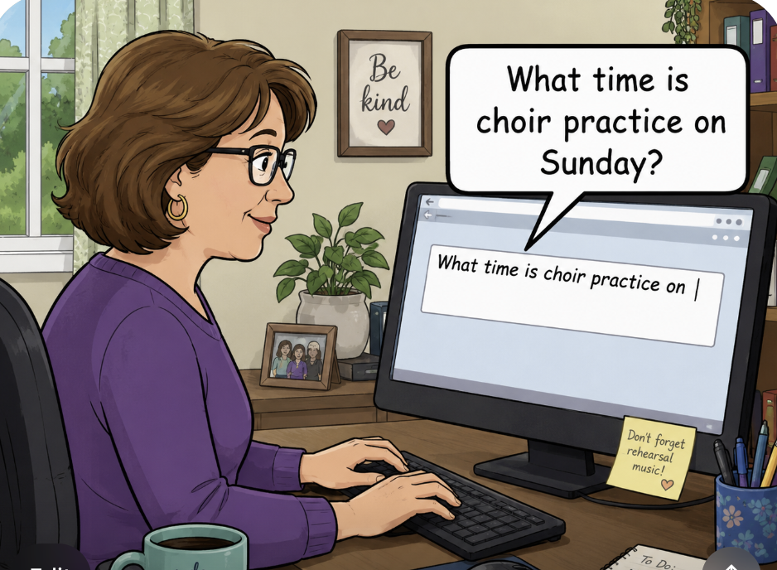
My 1999 Sermon – The Soul in Cyberspace
Level 1 – Information dissemination
Notes:
Months after the very first web browser was released, long before you had an email address

Slide 8
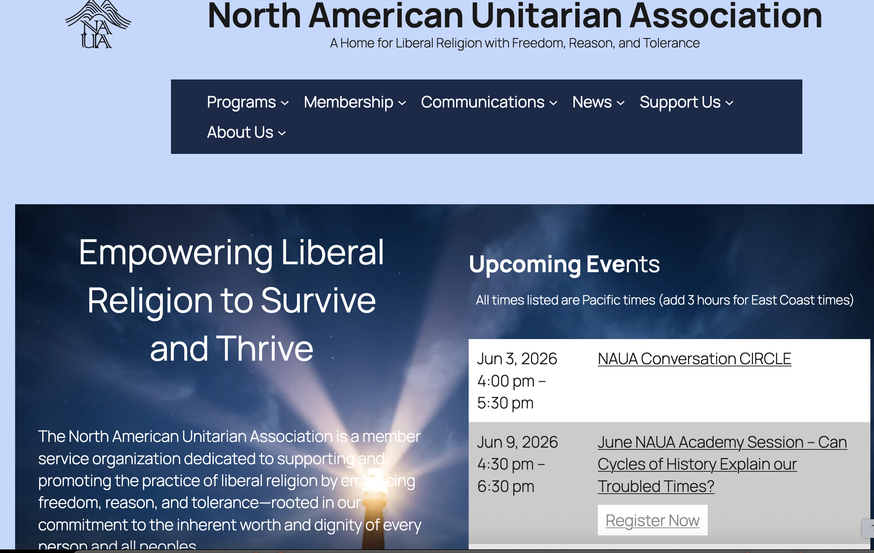
Level 1

Slide 9
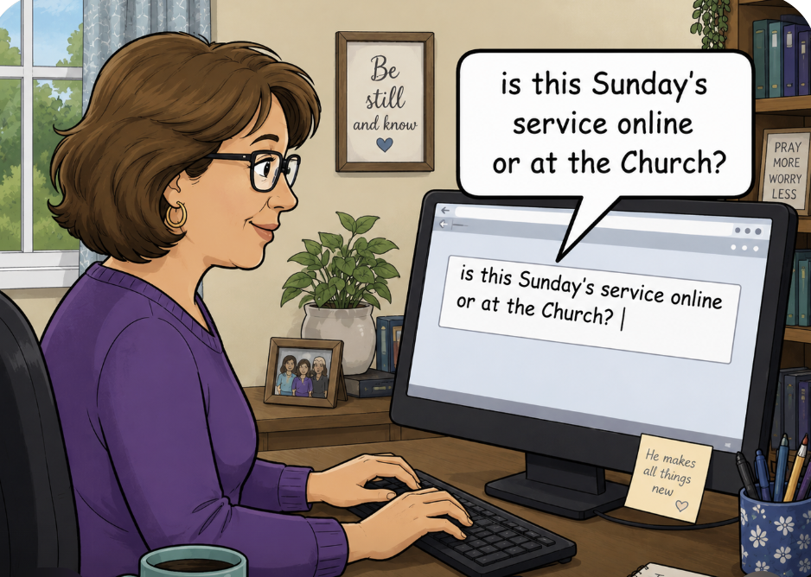
Level 2 – Effortless move between online and in-person

Slide 10
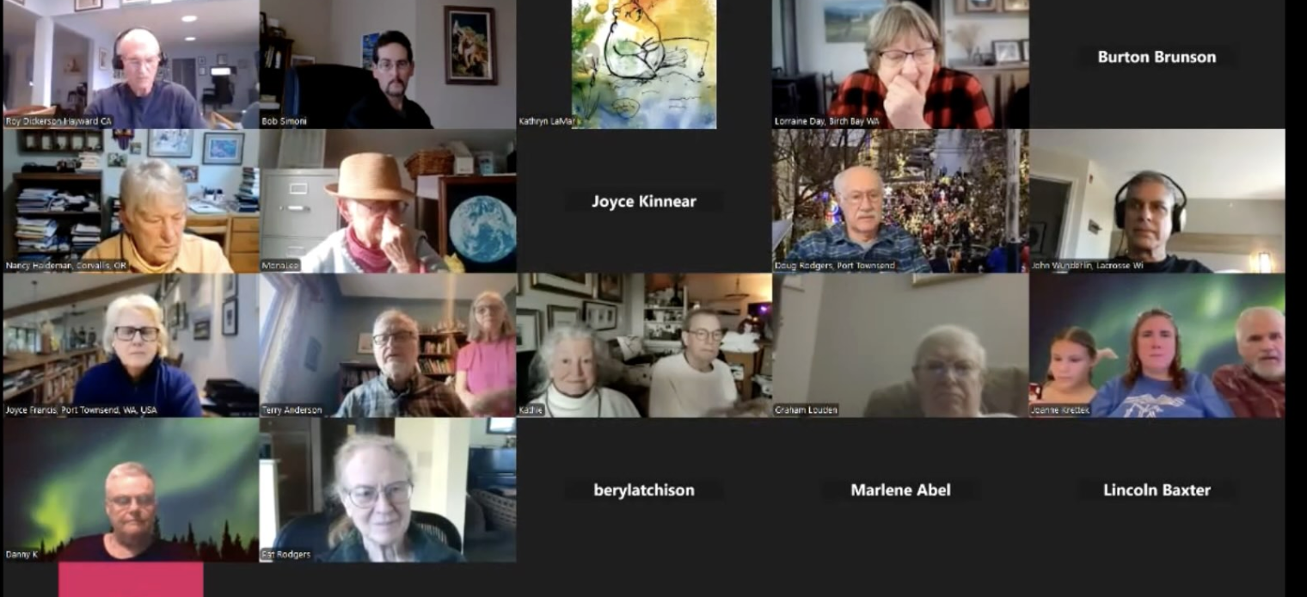

Slide 11
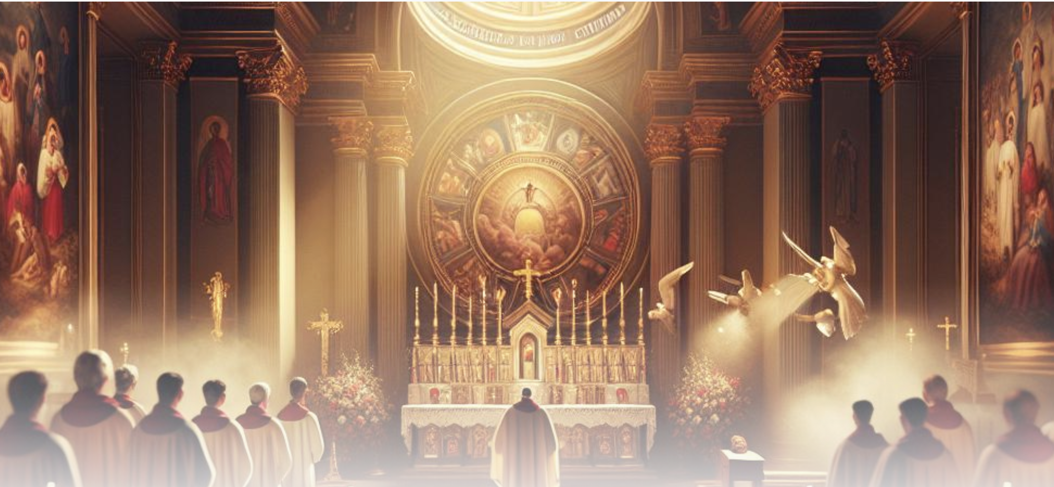
Level 3 - Religious encounters that cannot happen without being online – “hypermediated religious spaces” Campbell (2012)

Slide 12
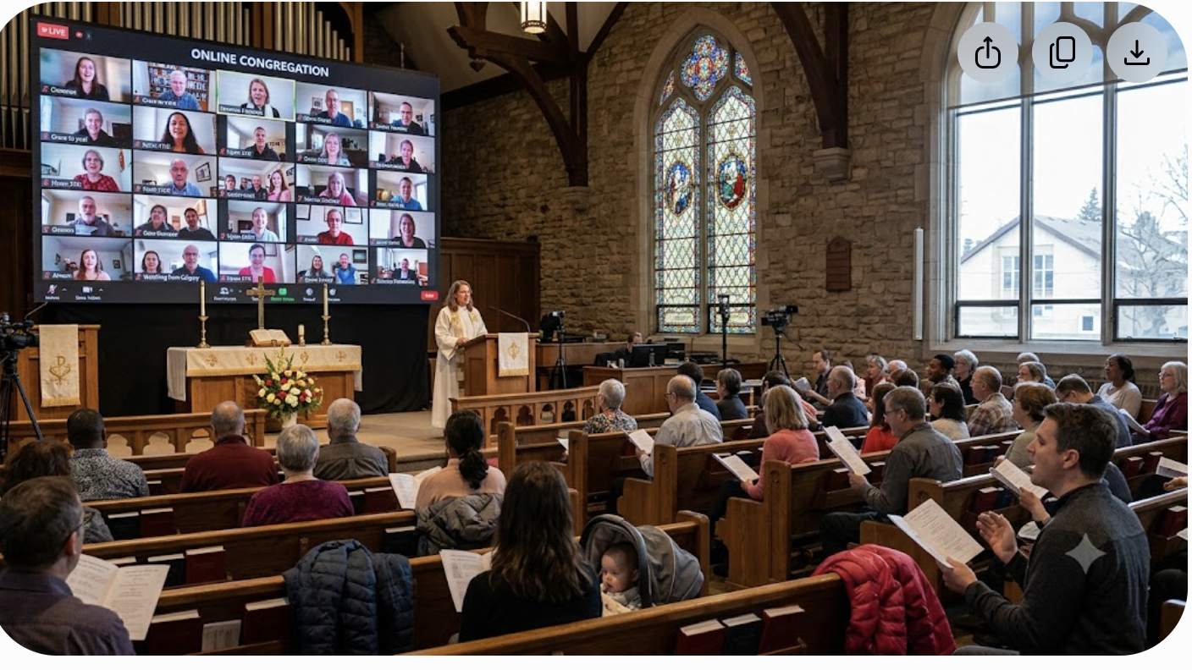
But I missed
In person integrated with online religion
Notes:
Story about TB and off site

Slide 13
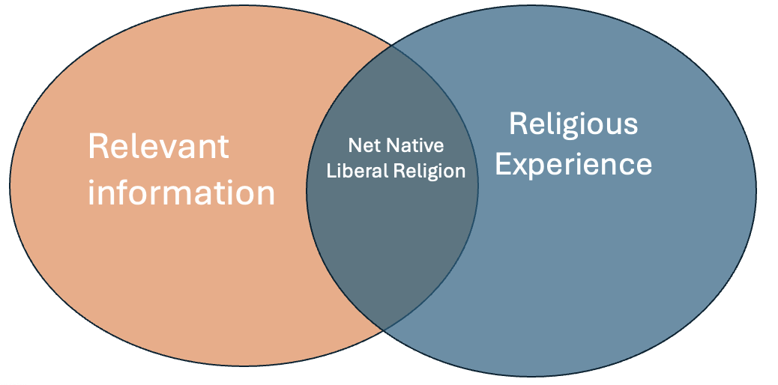
Religious Web Sites
Best religious web sites incorporate both an information zone and interaction zone in a single site
Notes:
Helland, C. (2005). Online religion as lived religion. Online-Heidelberg Journal of Religions on the Internet.

Slide 14
Participation Question #1
Role of Religious Organization
Receiving and disseminating information and education
Real time services/meetings
Online ritual, movement, prayer and ???
Making new friends and establishing connections
Doing social justice work
Which of these religious applications of the Net has been most (or least) useful to your religious/spiritual development/enjoyment?
Most disappointing?

Slide 15

The Good
Besides supporting existing off-line religious communities the Internet can create access AND new types of practices that are intrinsically different from those occurring without the aid of digital technologies.

Slide 16

Its all about access

Slide 17
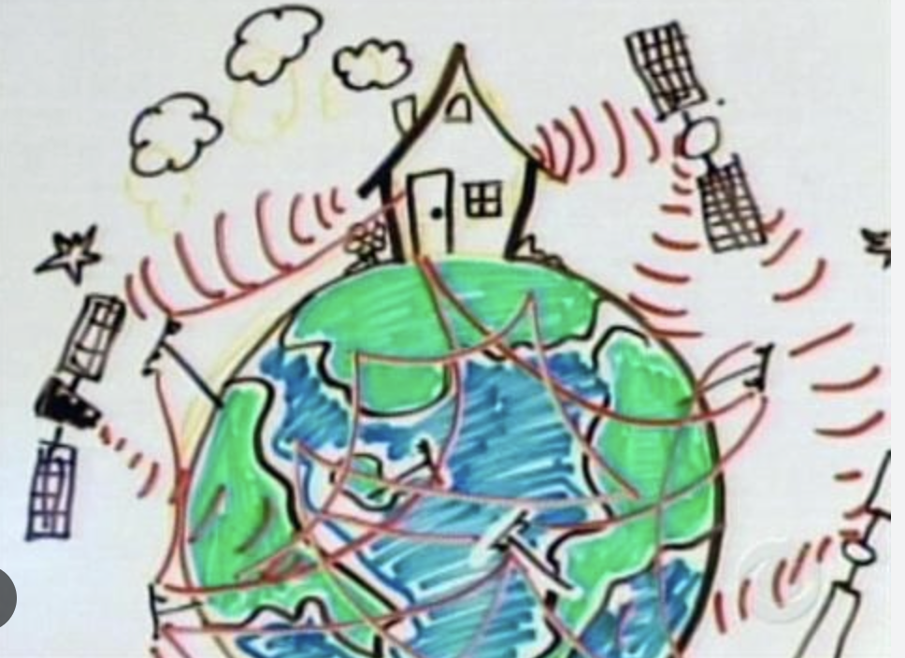
The Good
Online religion, education, commerce and socialization has always been about ACCESS.
  Spans Geography –
    Homebound
    Displaced – work, holidays, incarcerated, refugees, re-location
    Geographical diversity
    Threatened, social phobia
    Thus, Works to increase diversity
A 2016 Pew Research Center survey found that people
who report going to church less now than they used to said
the logistics of getting there are the biggest deterrent.

Slide 18
Religion in an online Context
capacity for shifting the time and place of religious interaction.
support for content encapsulated in many formats, including multimedia, immersive environments, video, and text giving access to religious content and context that exploits all media attributes.
the capacity of the Net to access huge repositories of content on every conceivable subject—including content created by the congregation
the capacity to support and integrate human and machine interaction in a variety of formats (ie. text, speech, video, and so on), in both asynchronous and synchronous modalities, creates a communications-rich learning context.
The opportunity to embed AI content and prompts into both individual and group religious gatherings
Notes:
From Terry Anderson, "Teaching in an Online Learning Context," in The Theory and Practice of Online Learning, ed. Terry Anderson (Edmonton, ON: AU Press, 2008), 344.

Slide 19
The Good - Spans Time
Worship, socializing, support groups, recovery groups all are operating online today.
Cuts down commuting time and travel costs, carbon burning
Recordings and summaries of past session
Allows record to span time across decades

Slide 20
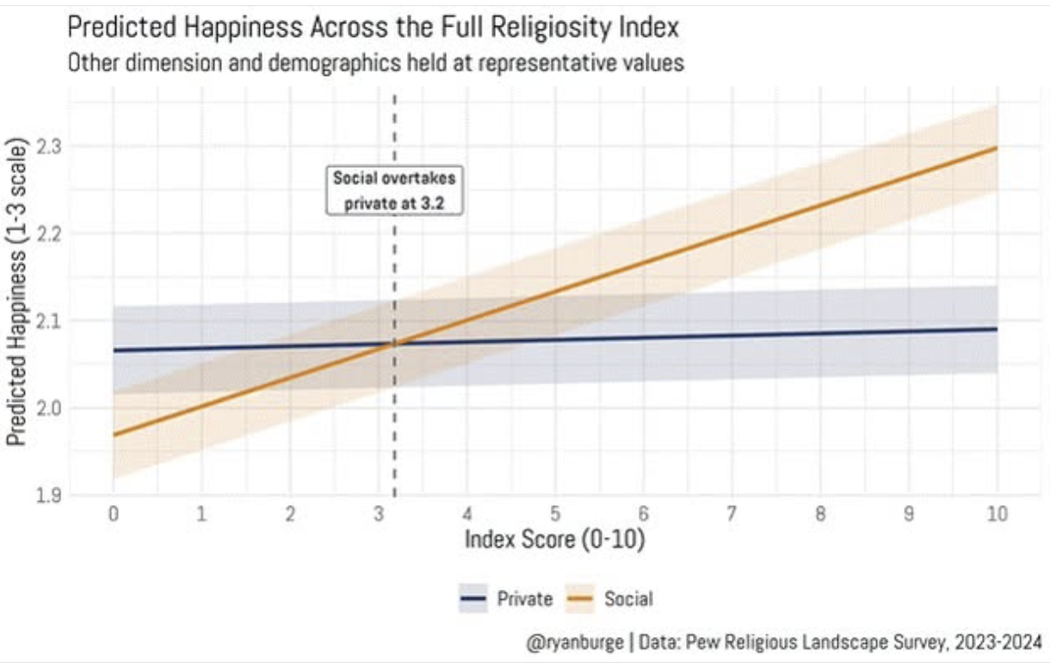
Happiness is Social – online or in-person

Slide 21
Those involved online report increases with other off-line religious practice – helps stay engaged
Posting original content to social media is positively associated with personal scripture reading and religious attendance,
  2021 Baylor Religion Survey (N = 1248),
Notes:
Laderi, J. O., & Uecker, J. E. (2025). Types of Internet Activity and the Religious Commitment of American Adults. Journal for the Scientific Study of Religion 64(3), 341–353.

Slide 22
The Good: Online as Support tool for religiously suppressed
Religious information sites and communities create a space for learning, networking and leadership support – especially from those subjugated to religious authoritarianism.
Support private communications, small group support, inspiration and story telling

Slide 23
The Good - After service chat/discussion much better online than in person.
Larger group size conversations
Focused on reaction/reflection on service.
Enlightening but not intimidating for first timers
Easy exit capacity
  “An optional activity after the main service was joining a randomly assembled small-group gathering to respond to the service, or talk about whatever we felt like. At the in-person social hour, ambient noise got in the way of conversation and people would gravitate toward those they already knew” Facebook UU.

Slide 24
Synchronous
Technology as a doorway to connections –
NAUA Circles
  Synchronous plus video

Slide 25
The Good
Online religion as a sort of third space (Oldenburg 1989). Not home, not workplace but a special place , open to all, not wealth, creed or race defined.
Allows varying degrees of anonymity.
Allows low cost ‘introduction” to church practices and organization

Slide 26
The Good? Or at least the questionable
“The concept of authority classified under technology will no longer be linked to order or rationality, but to the processes of control, datafication, and attention management on the part of the owners of the platforms,
while from the users’ side to concepts such as identity, authenticity, choice, and voluntariness.”
  Andok, M. (2024). The impact of online media on religious authority. Religions, 15(9),

Slide 27
The Bad - Online demands
  media literacy,
  access to electric and data grids,
  access to hardware
Supports billionaire owned monopolies,
Allows influence pedaling, information censorship
Difficulty in seeing and interpreting other’s non-verbal communication
Reluctance of some people to share in this type of group process
Partial engagement of participants who are distracted and may engage in distracting activities such as surfing the internet during service
Religion practice (on work/entertainment device) not a sacred space

Slide 28
The Bad
Some religious activities may be dependent on haptic interactions
Ie laying on of hands, communion, sharing food or drink, incense
How do we substitute online affordances for those that are lost?

Slide 29
The Bad
Religion has always been materialized – ie sacred or “graven’ images, idols, relics, the wooden cross.
Given the significantly lessor materiality of the internet, online religion is either
  deprived of materiality, or
  freed from its constraints.
“ Online rituals, since you’re alone in a room, really depend on your ability of visualization and to literally imagine yourself connected with other people in the astral.” Neo Pagan priestess from Evolvi, (2022).
Notes:
Evolvi, G. (2022). Religion and the internet: Digital religion,(hyper) mediated spaces, and materiality. Zeitschrift Für Religion, Gesellschaft Und Politik, 6(1), 9-25.

Slide 30

“For Matua devotees, the sound of the sacred drum (daṅkā), the ecstatic and energetic dance (mātām) and the collective chanting of haribol are thought to ensure religious salvation as well as social emancipation.
But connection without physical contact brought to the forefront an ocular-centric, male-dominated online religiosity during the pandemic.” Lorea et al. (2024)
Notes:
Lorea, C. E., Mukherjee, A., & Roy, D. (2024). A Dalit religion online: clashing sensory scapes and remote ethnographies behind the screen. Dialectical Anthropology, 48(1), 83-112.

Slide 31
The bad
“Only Place-shared: interaction promotes:
More familiar shared ritual activity,
more diverse types of social programming - ie communal singing
physical presence, opportunities for spontaneous and multi sized conversations
These actions strengthen community identity and mutual support.

Slide 32
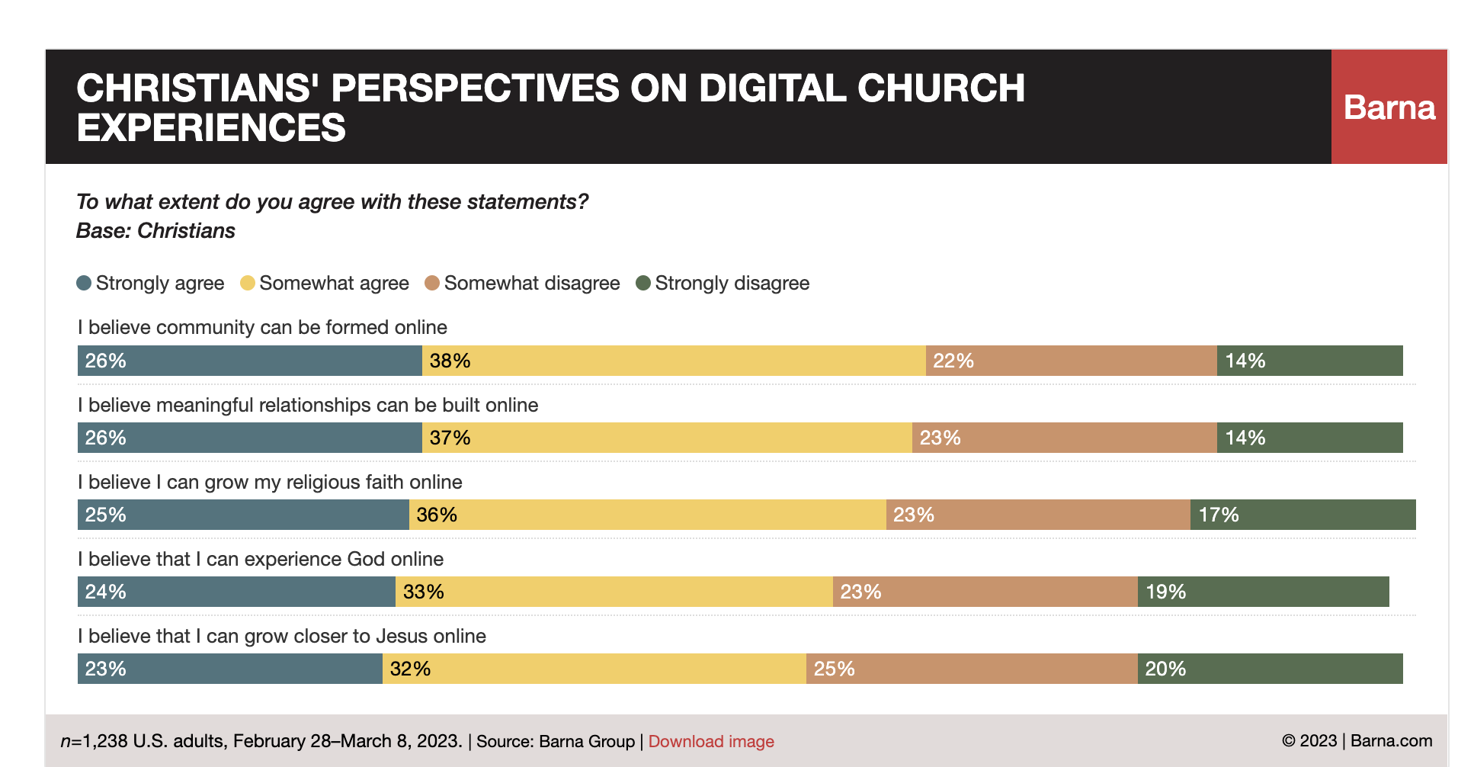
The Bad
Seven in 10 Christians Say Building Community Is More Meaningful in Person
https://www.barna.com/research/in-person-over-online-church/

Slide 33
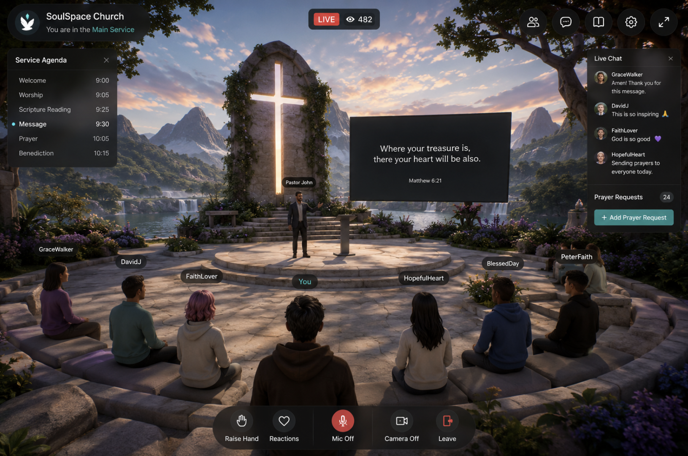
The bad – Online will never be Face to Face
Audio
Text
Video
Immersive

Slide 34
Online MAY be Anonymous
Protection and Safety: Allows believers under hostile or restrictive regimes to communicate and practice without fear of punishment.
Honest Exploration: Grants individuals the freedom to ask taboo or difficult questions without risking personal shame or social stigma.
Focus on the Message: Shifts the focus away from human ego, physical appearances, or celebrity culture toward universal spiritual truths

Slide 35
Negative Effects of Anonymity
Disinhibition and Cruelty: Removes natural social boundaries, often leading people to post harsh, hateful, or toxic remarks that contradict religious values.
Lack of Accountability: Encourages the creation of false personas and hypocrisy, shielding individuals from the real-world consequences of their actions.
Isolation from True Community ?????? Replaces genuine, embodied fellowship and mutual care with superficial digital validation.
(Google AI)

Slide 36

Psychological Effects of Anonymity in Religious Forums
Dissociative Anonymity ("You Don't Know Me")
Invisibility and Lack of Eye Contact ("You Can't See Me")
Solipsistic Introjection (”I Forgot That It’s All in My Head”)
Minimization of Authority ("We Are All Equals Here")
Asynchronicity and the Empathy Deficit ("See You Later")
Google AI)
Notes:
1. Dissociative Anonymity ("You Don't Know Me")
The Mechanism: Users separate their digital profile from their real-world identity.
The Faith Impact: In a physical religious community, members risk severe social stigma or excommunication if they express doubt or hidden struggles. In anonymous forums, this fear dissolves. It allows users to confess sins or voice deep theological doubts safely (benign). Conversely, it enables "hit-and-run" theological attacks without real-world social fallout (toxic). [1, 2, 3, 4, 5]
2. Invisibility and Lack of Eye Contact ("You Can't See Me")
The Mechanism: Not seeing a person's physical reactions removes immediate visual feedback.
The Faith Impact: Psychological studies reveal that the absence of eye contact is the leading driver of toxic online behavior. Without seeing a conversational partner's wince or look of hurt, a user's empathy decreases. It becomes easy to harshly condemn someone as a "heretic" or "sinner" because the target feels like text on a screen rather than a human being. [1, 2, 3, 4, 5, 6]
3. Solipsistic Introjection ("It’s All in My Head") Solipsistica psychological phenomenon where text-based online communication causes people to unconsciously assign a voice, tone, and visual identity to someone they cannot see, making the interaction feel like an internal conversation inside their own head. [1, 2]
The Mechanism: Users read another person's text and unconsciously assign a voice, tone, and identity to them, weaving the digital conversation into their own mental narrative. [1, 2, 3, 4, 5]
The Faith Impact: When reading opposing religious views, a user might internalize the text as a direct, highly aggressive threat to their core worldview. This prompts an overly defensive, knee-jerk emotional response to a message that may have been written neutrally. [1]
4. Minimization of Authority ("We Are All Equals Here")
The Mechanism: Traditional social hierarchies, physical titles, and power dynamics blur or vanish online.
The Faith Impact: In physical faith spaces, religious leaders (like pastors, priests, rabbis, or scholars) command a high level of deference and respect. Online, an ordinary layperson or teenager feels psychologically empowered to openly challenge, mock, or debate highly trained theologians or community elders on equal footing. [1, 2]
5. Asynchronicity and the Empathy Deficit ("See You Later")
The Mechanism: Conversations do not happen in real-time, allowing delayed responses.
The Faith Impact: Users can drop an emotionally charged, highly polarizing comment into a faith forum and walk away. Because they do not witness the immediate emotional fallout or the chaotic debate that follows, their brain bypasses the typical guilt or accountability associated with causing community strife. [1, 2, 3, 4]

Slide 37
The Ugly
Online communications – especially asynchronous and text based, is associated with disinhibition
Flaming, general unkindness and miscommunications can lead to personal and institutional estrangement
Smith, B., & Hargittai, E. (2025) ‘It's really hard to be a jerk when you’re sitting on someone's couch’: Preferences for discussing science and religion online versus offline.
Successful social interaction depends upon sensitivity, empathy, compassion which may be harder to develop and maintain in online spaces
Smith, B., & Hargittai, E. (2025). Information, Communication & Society, 28(10), 1836–1853
Notes:
Smith, B., & Hargittai, E. (2025). ‘It’s really hard to be a jerk when you’re sitting on someone’s couch’: Preferences for discussing science and religion online versus offline. Information, Communication & Society, 28(10), 1836–1853. https://0-doi-org.aupac.lib.athabascau.ca/10.1080/1369118X.2024.2357328

Slide 38
The Evil - Online interactions carry implicit threats
Privacy intrusions
Algorithmic choice/display
Algorithmic moderation of content
Creation and sustaining of filter bubbles
Rabbit holes leading to misinformation, trust manipulation and/or exploitation
“Digital media as a social space where inequalities, prejudices and power structures offline can be both reinforced and challenged.” Marei, F. G. (2024).
Notes:
Marei, F. G. (2024). God’s Influencers: How Social Media Users Shape Religion and Pious Self-Fashioning. Journal of Religion, Media and Digital Culture, 13(2), 143-172. https://doi.org/10.1163/21659214-bja10140

Slide 39
Partially Online Growing
Give Me That Online Religion
“a 2023 Barna Group survey, 4 in 10 U.S. adults identifying as Christian said they would not likely attend their church if services moved exclusively online. One-third said they would be disappointed with such a change, and 27% said it would leave them feeling disconnected.
A Pew survey (2023) found 27% of Americans regularly view religious services on screens. This includes 10% who watch only online or on television and 17% attending both in person and virtually.
By comparison, 16% of respondents report attending church exclusively in person.

Slide 40
Online Religious Practices
Live-Streaming Services: Worshippers act as observers, viewing Masses, liturgies, or sermons broadcast from traditional physical spaces. [1]
Interactive Prayer & Meditation: Using apps and websites for guided meditation, communal rosaries, or synchronized scripture study (e.g., Come Pray the Rosary, Sacred Space). [1, 2]
Virtual Communities & Covens: Devotees interact synchronously on video platforms (like Zoom) to perform rituals, adapted in size and pacing for a digital format. [1]
Virtual & AI Experiences: Exploring simulated holy sites in VR or interacting with AI-powered religious figures for a contemplative experience.
Notes:
google AI

Slide 41
Online Ritual Tips
Use real objects – candles, bells, clothes
Have participants doing – not just watching (ie when extinguishing candle have everyone, turn on mics and blow together)
Encourage camera use, share your enthusiasm, smiles, singing.
Take advantage of visual and acoustic capabilities of the online
Ritual is: “a planned or improvised performance that effects a transition from everyday life to an alternative framework within which the everyday is transformed.” Driver

Slide 42
Ritual in Synchronous online streaming
“repeated greetings, symbolic gifting, synchronized audience responses, moderator mediation, and insider language operate as digital rituals that sustain collective identity and cultural continuity.” study from moderated, TikTok services (Setiawan Khasanah & Luki (2026).
Notes:
Setiawan, G. A., Khasanah, R. N., & Luki, A. (2026). Digital Rituals: Communication Practices and Cultural Meaning in Live Streaming Communities. Journal of Communicatio et Cultura, 2(1), 56-71.

Slide 43
Materiality in Online Religion
Standard "Flat" Digital Religion versus Materialized Online Religion
“embed materiality and create a sense of physicality primarily through visualization, such as imagining being connected with others in the astral, and using tangible objects like altars and candles near the computer.”
Haptic devices (feelies) and linking online and offline objects

Slide 44
Bringing rituals from in-person ceremonies - Ritual
“primarily conceived in terms of a simulation of the “real.” Consequently these sites are envisaged in terms of conventional notions of sacred space and ritual performance, rather than as something radically new.” Jacobs, S. (2007),
Buddhists talk of the principle of ‘co-location’ by which a digital space is re-created as a sacred space, “Ashraf, C. (2022).
Can you imagine any new forms of ritual behaviour that can only exist online?
Notes:
Jacobs, S. (2007), Virtually Sacred: The Performance of Asynchronous Cyber-Rituals in Online Spaces. Journal of Computer-Mediated Communication, 12: 1103-1121.
Ashraf, C. (2022). Exploring the impacts of artificial intelligence on freedom of religion or belief online. The International Journal of Human Rights, 26(5), 757–791. https://doi.org/10.1080/13642987.2021.1968376

Slide 45
Unitarians embrace religious images, songs, sounds, writings and poetry from many religious tradition.
How have these media changed through digitization and AI enhancement?
x

Slide 46
Design Solutions
“sustaining low-burden continuity often reduces intensity, while sustaining ritual intensity often increases coordination costs and burden.” DIS '26: Proceedings of the 2026 Designing Interactive Systems Conference
making presence perceptible via partial cues – “cameras on”
“Provide affective scripts with negotiable boundaries. Offer a fixed, culturally recognizable format that lowers the threshold for participation while leaving room for boundary negotiation.”
Need for sharing of Concerns and Celebrations in NAUA gatherings
Encourage ‘back channel” text chat
Notes:
Hatada, Yuji, et al. "Async Party: Designing Online Asynchronous Video Sharing of Individual Cheers to Facilitate Spontaneous Offline Encounters." Proceedings of the 2026 Designing Interactive Systems Conference. 2026.

Slide 47
Participation Question #2
What Online Ritual/Practice works or does not work, for you?

Slide 48

A look at Online Religion Today

Slide 49
UUA’s Online Church
The Church of the Larger Fellowship (CLF) is a global, non-local Unitarian Universalist congregation founded in 1944 to serve isolated individuals, featuring online worship, covenant groups, and a prison ministry.
Founded in 1944: To connect Unitarians living in areas without a physical local church.
No Boundaries: Operates as a "congregation without walls" for members worldwide
Programs and Services:
Online Worship: Offers virtual Sunday services and theological gatherings.
Quest Magazine: Publishes regular reflective materials and resources for members.
Prison Ministry: Maintains a large letter-writing and spiritual support network for incarcerated Unitarian Universalists.
Source
Google AI

Slide 50
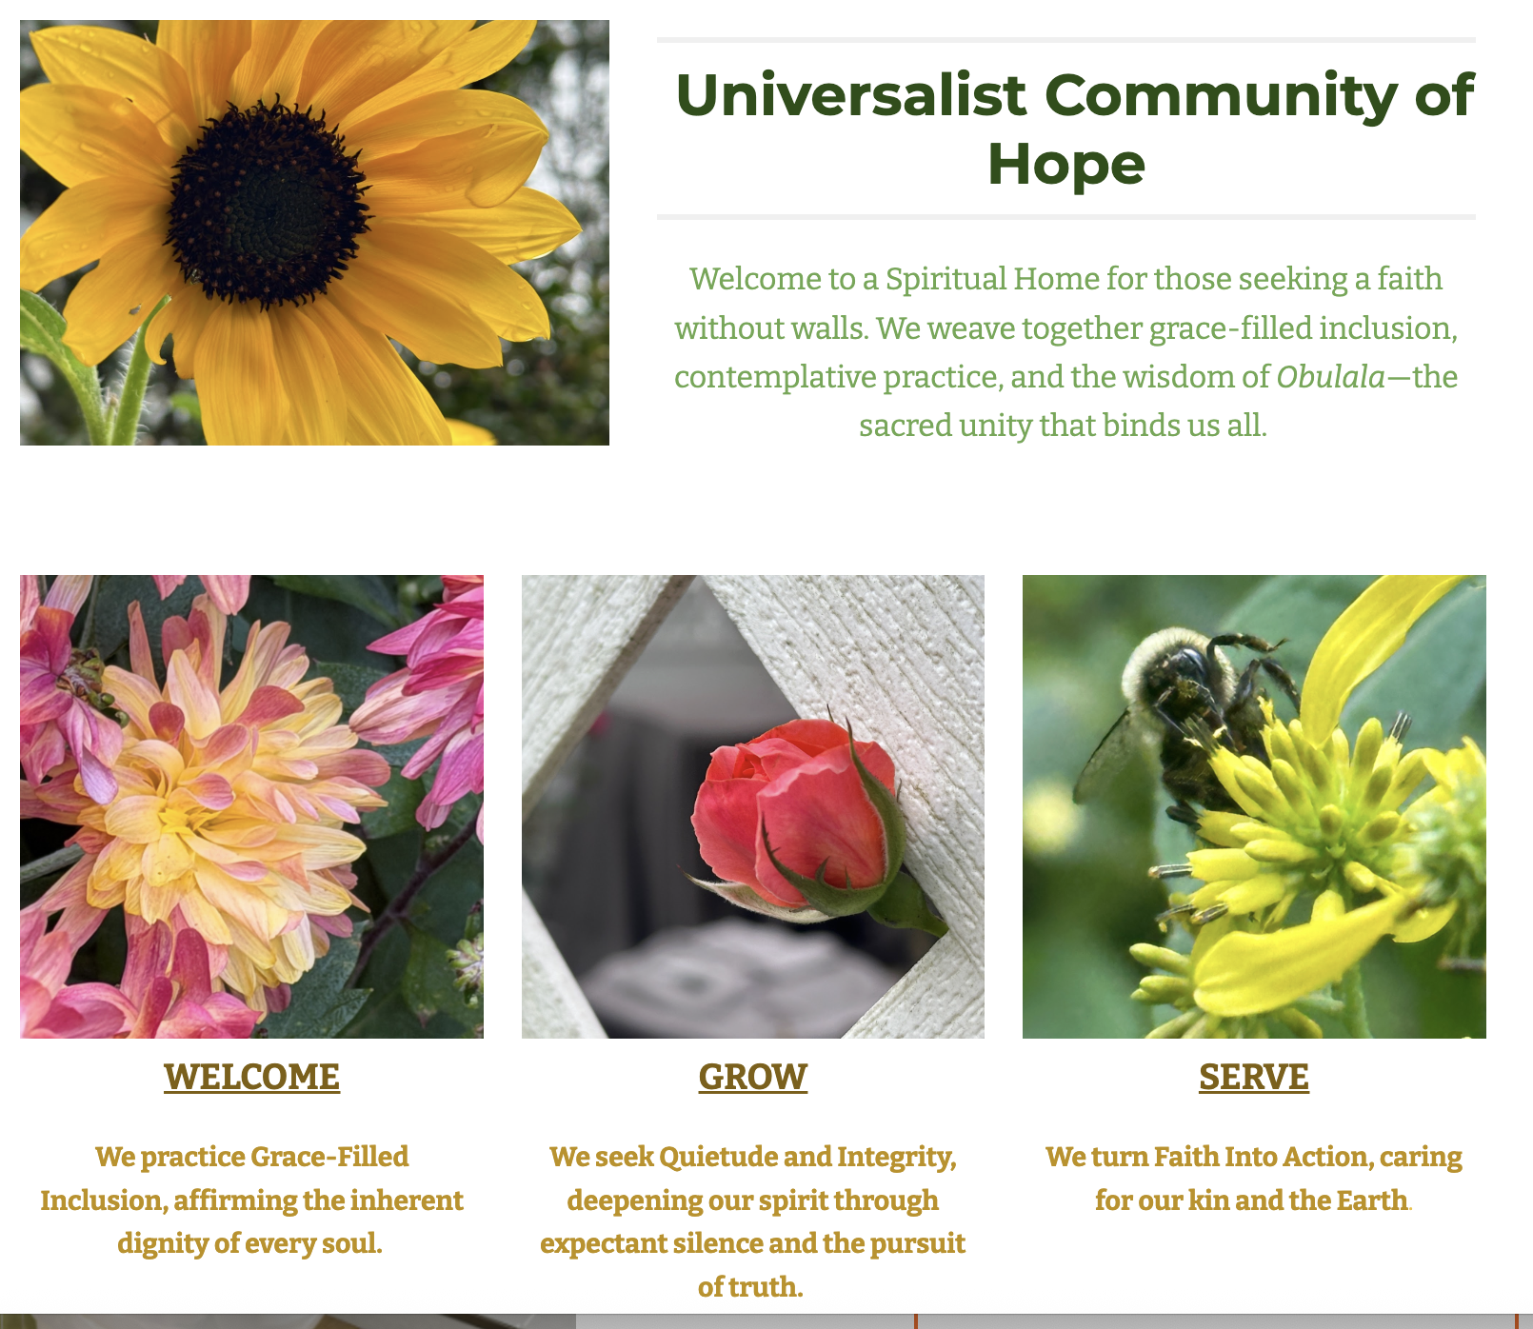
Senje Wekoye
Aka SarahRuth Hodgkinson Davis
https://www.universalistcommunityofhope.faith/

Slide 51
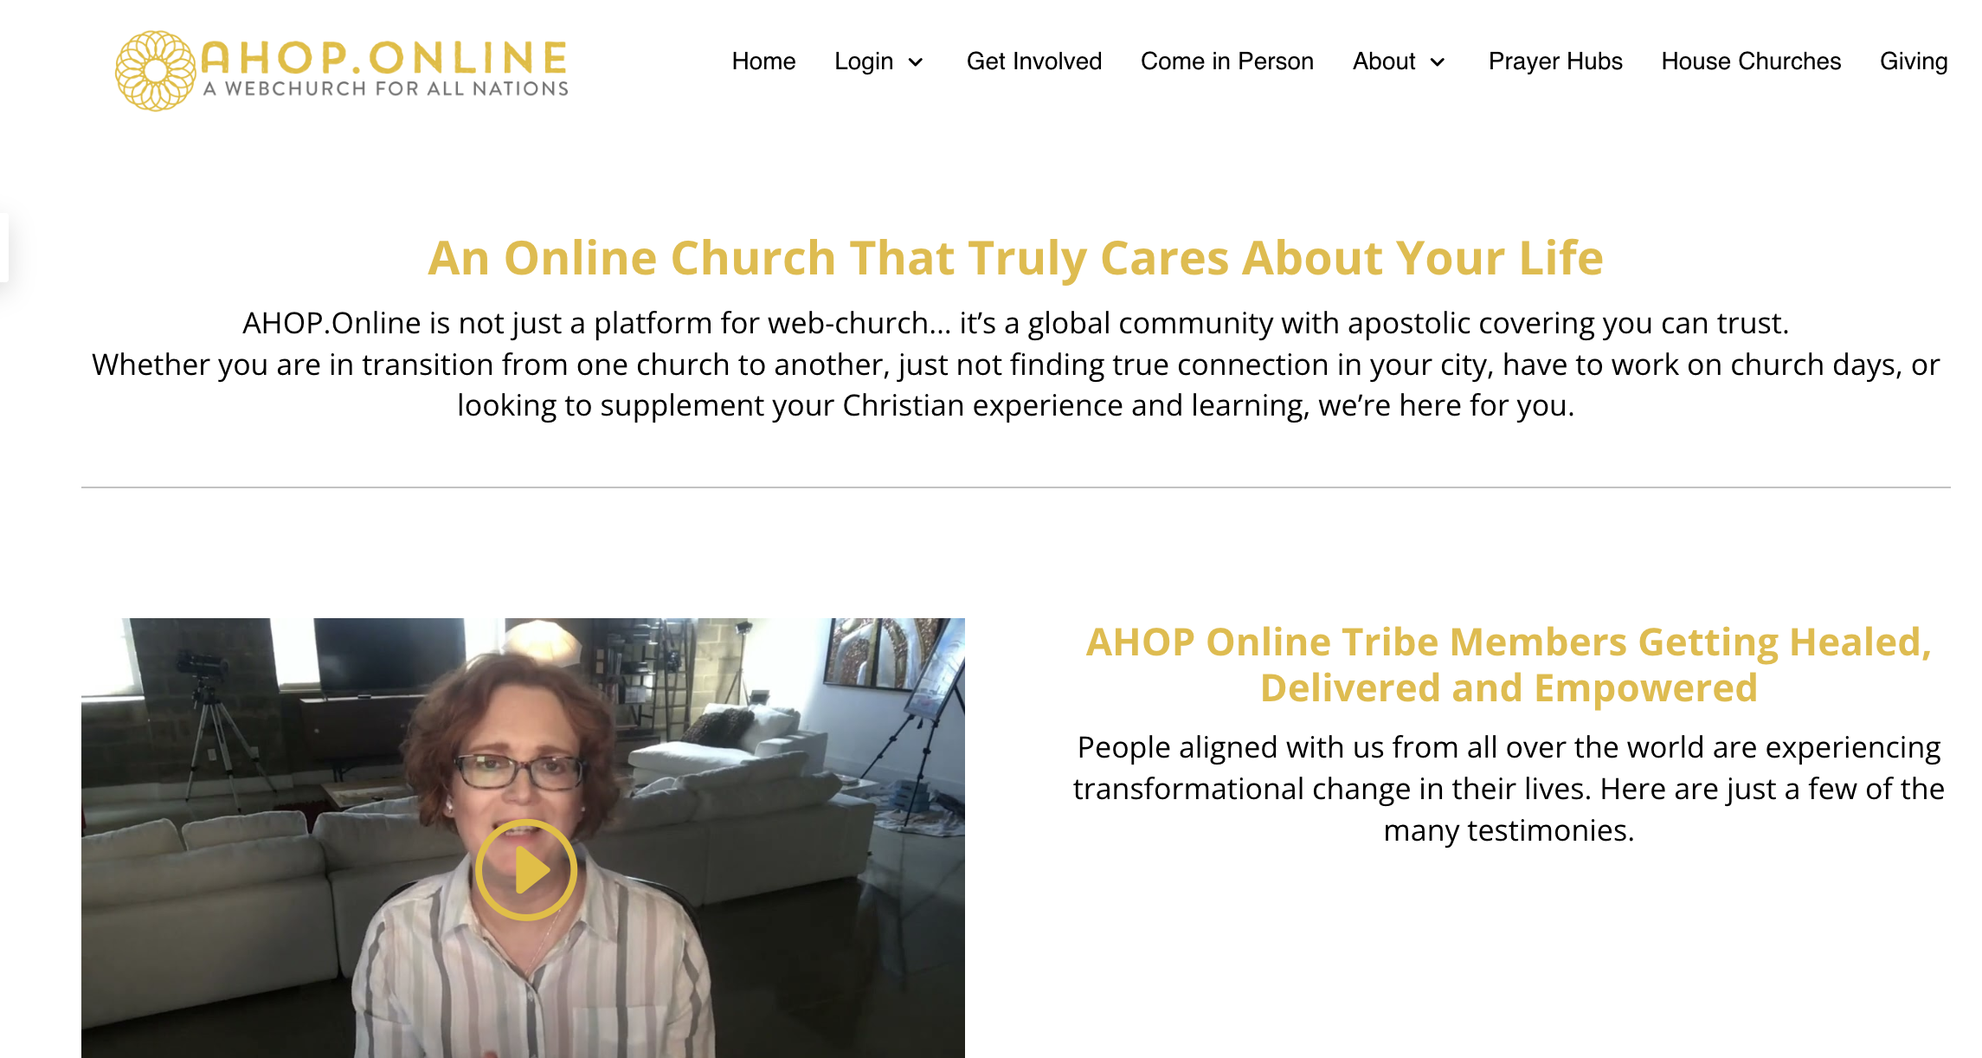
Notes:
Awakening House of Prayer

Slide 52


Slide 53
Top 100 most influential churches in USA (Youtube)
Size – onsite congregation plus the online congregation
Momentum
Platform(s)
Paster’s Prayer
Lord, we ask that you bridge the
gap of distance today.
Knit our hearts together, across physical rows
and digital streams,
as one single body.
Notes:
Reachright youtube

Slide 54
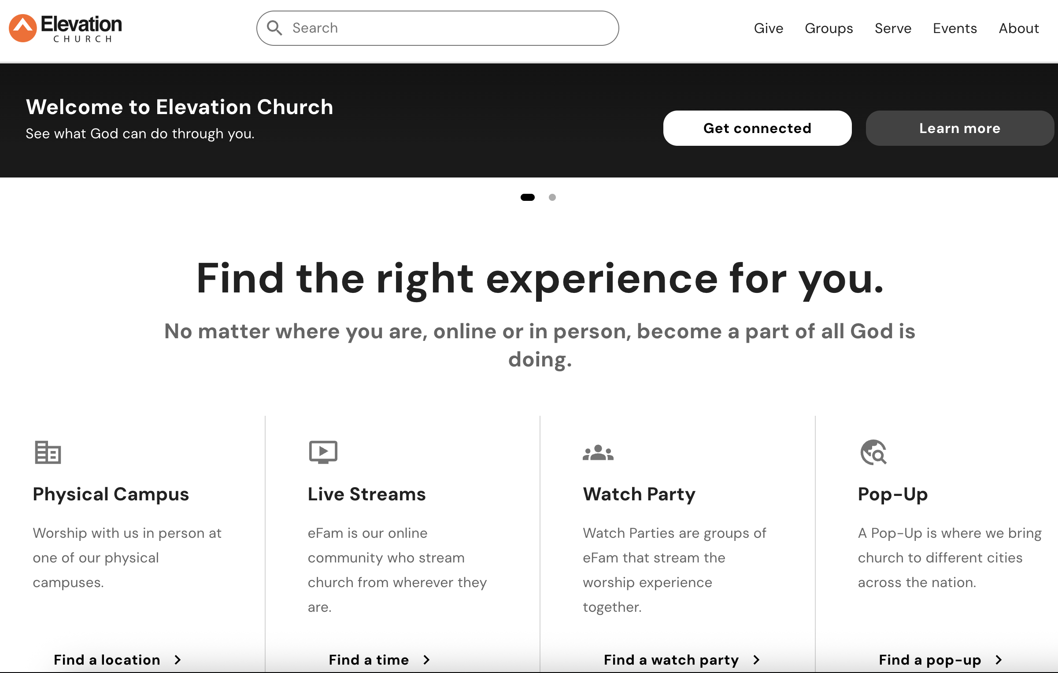
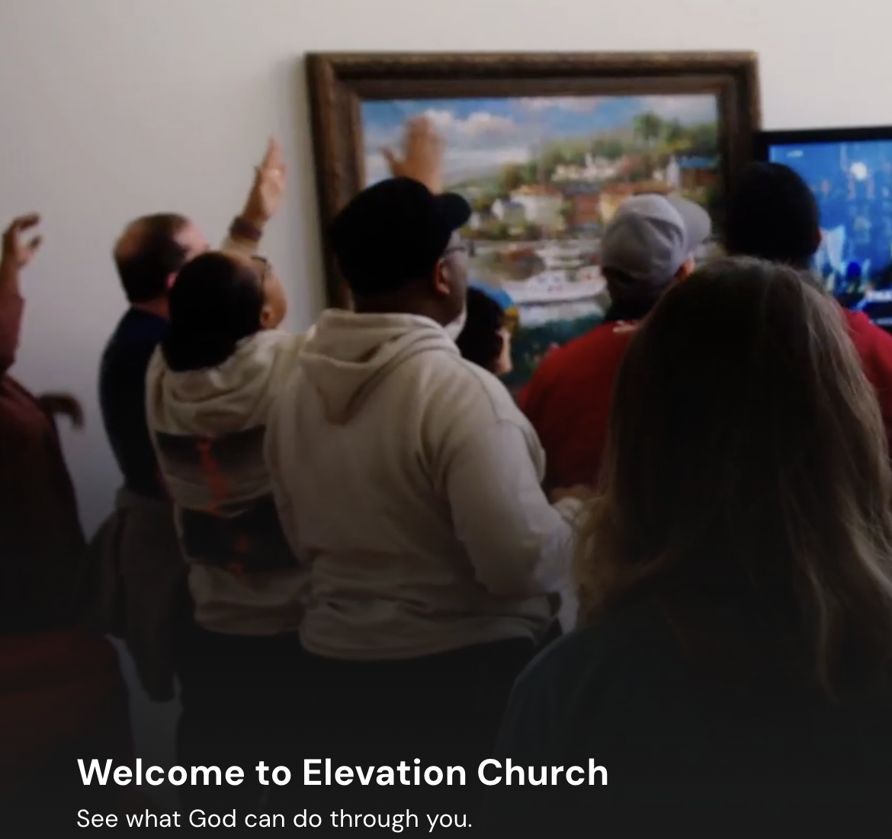
Successful Christian Online Church?

Slide 55
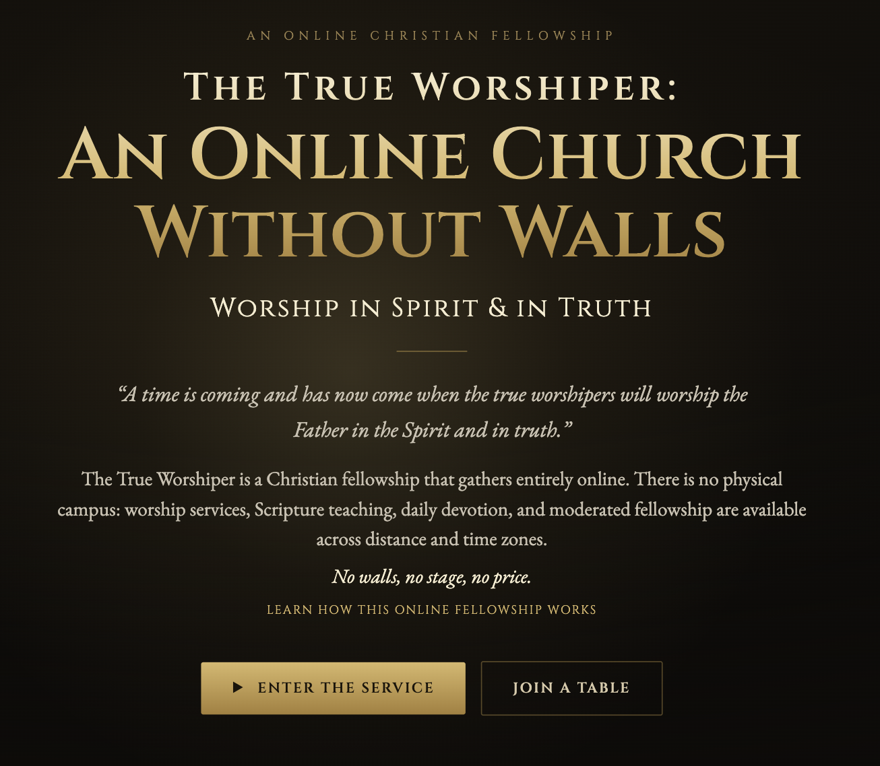
An asynchronous service 7X24
Sunday synchronous ‘tables”, one starting every hour

Slide 56
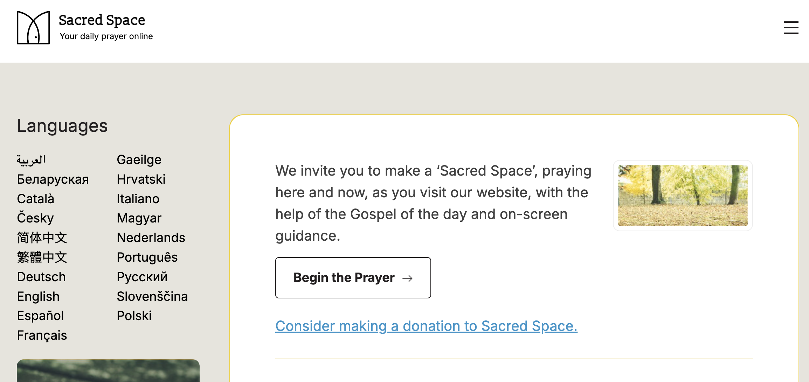
Sacred Space by the Irish Jesuits

Slide 57
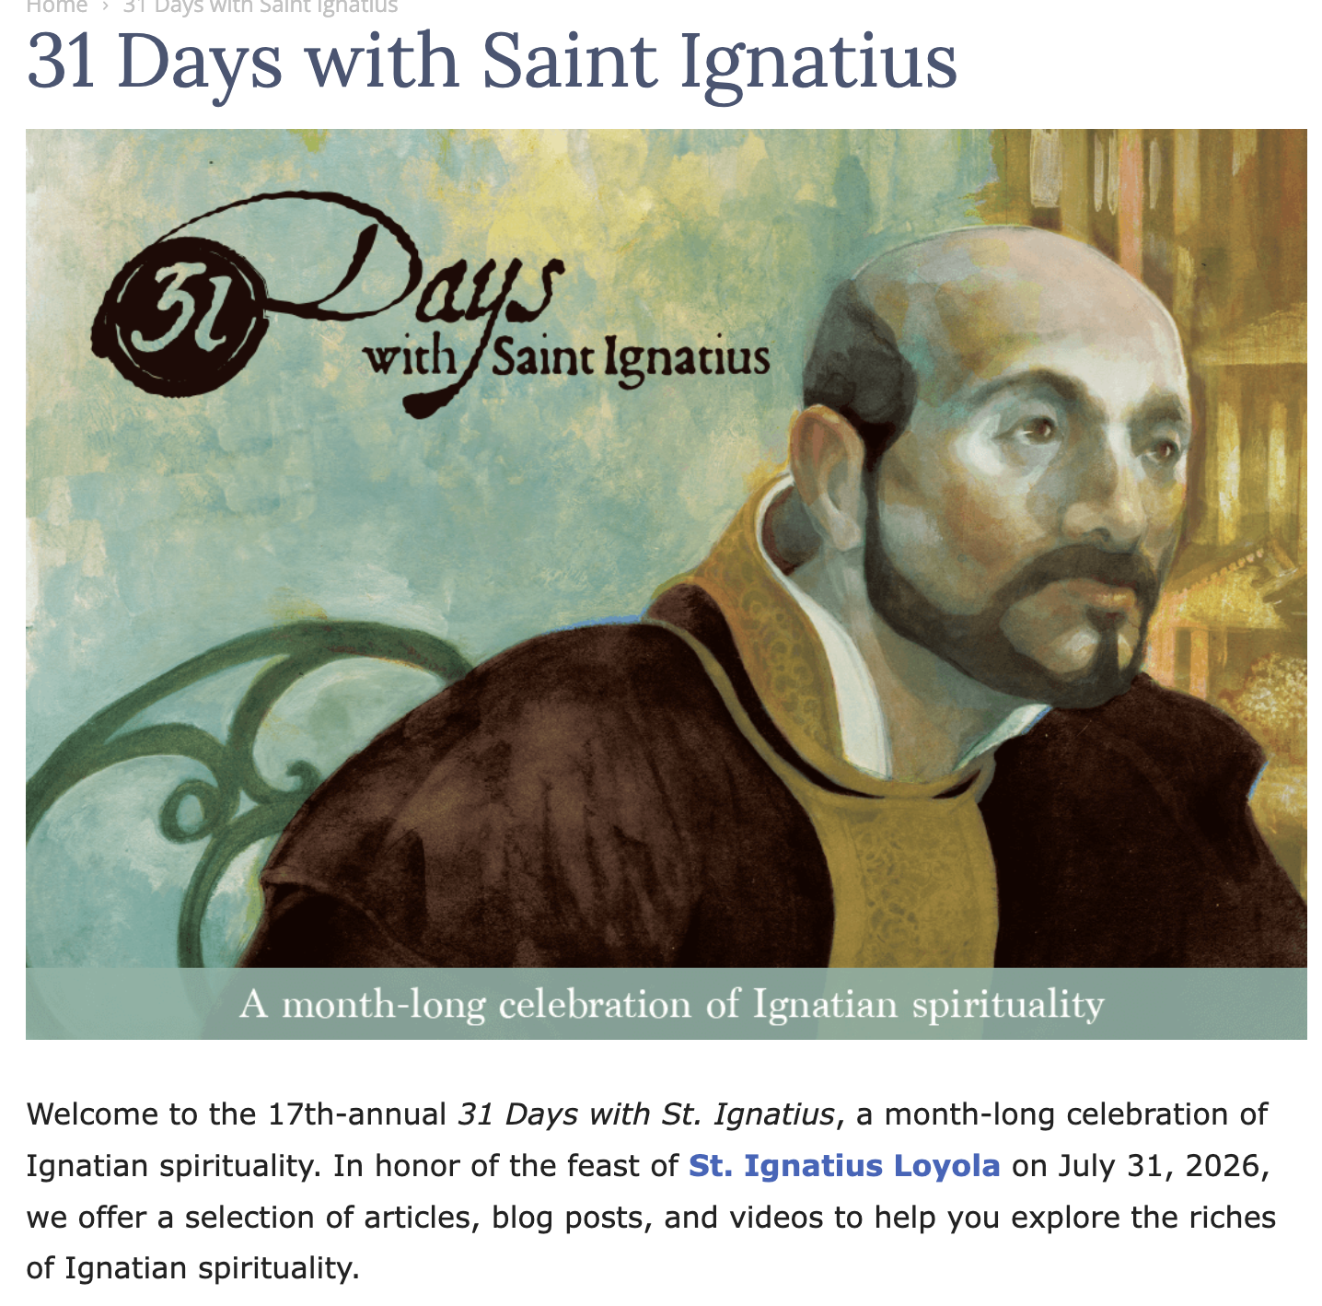

Slide 58
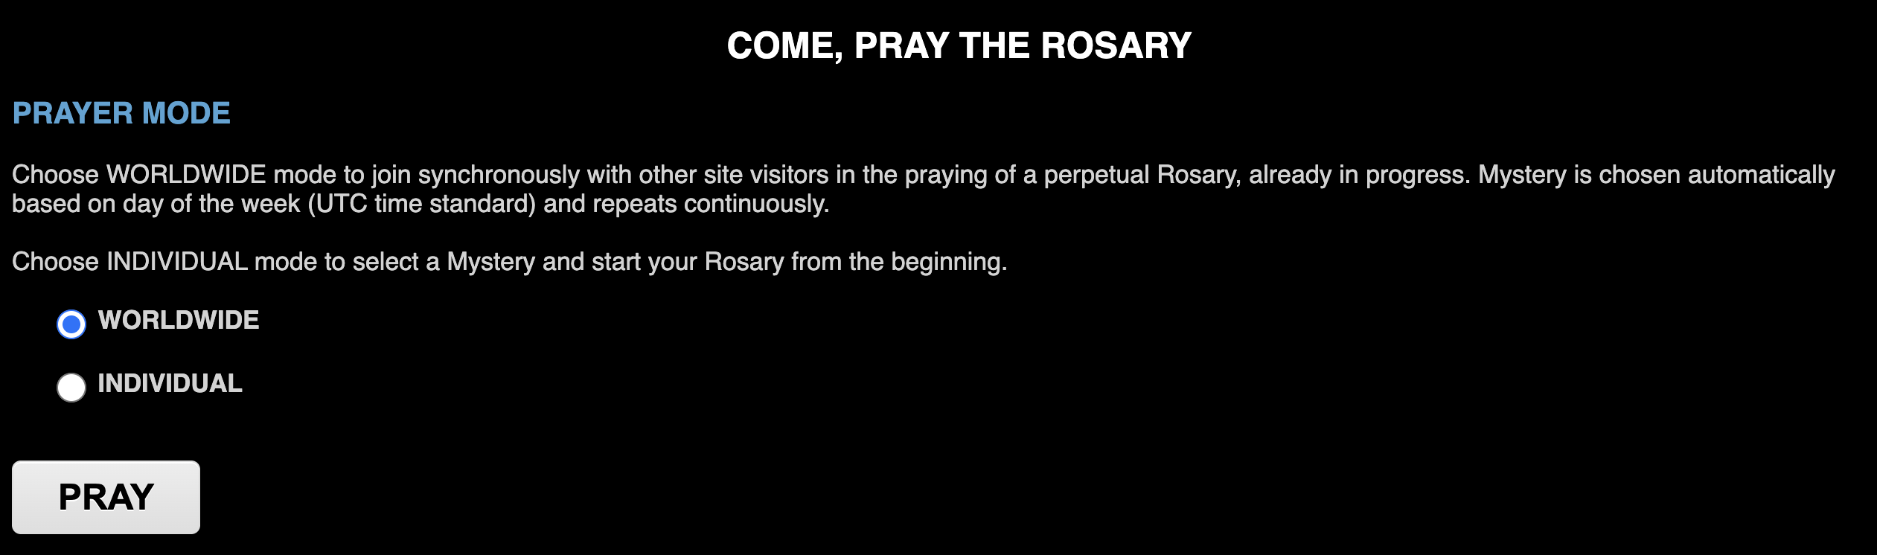
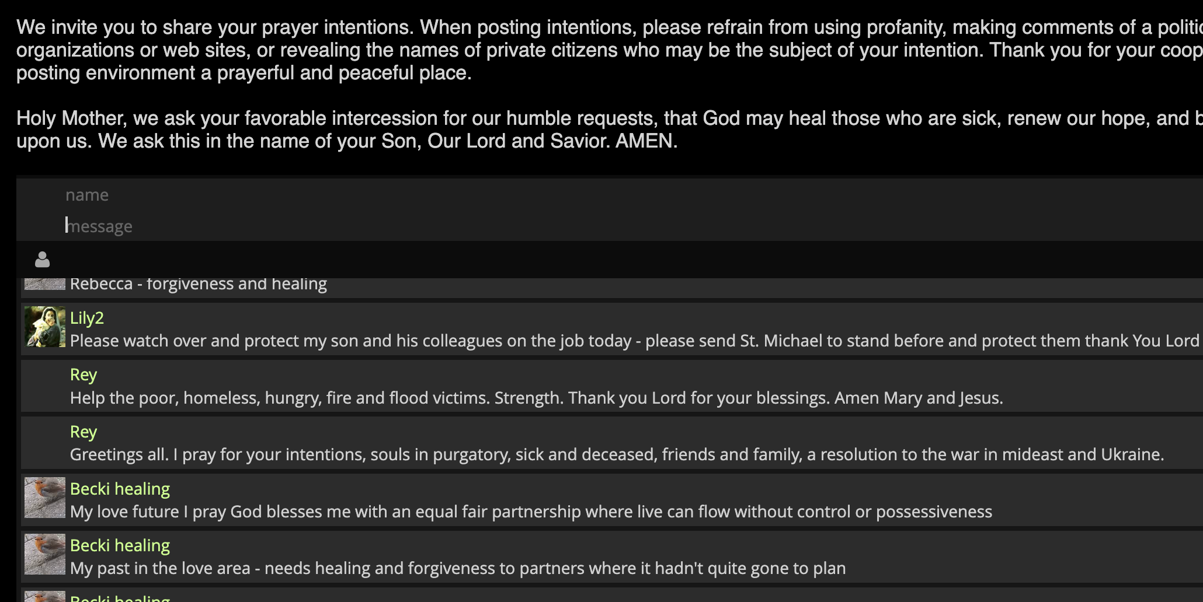


Slide 59

Mosque in an App

Slide 60
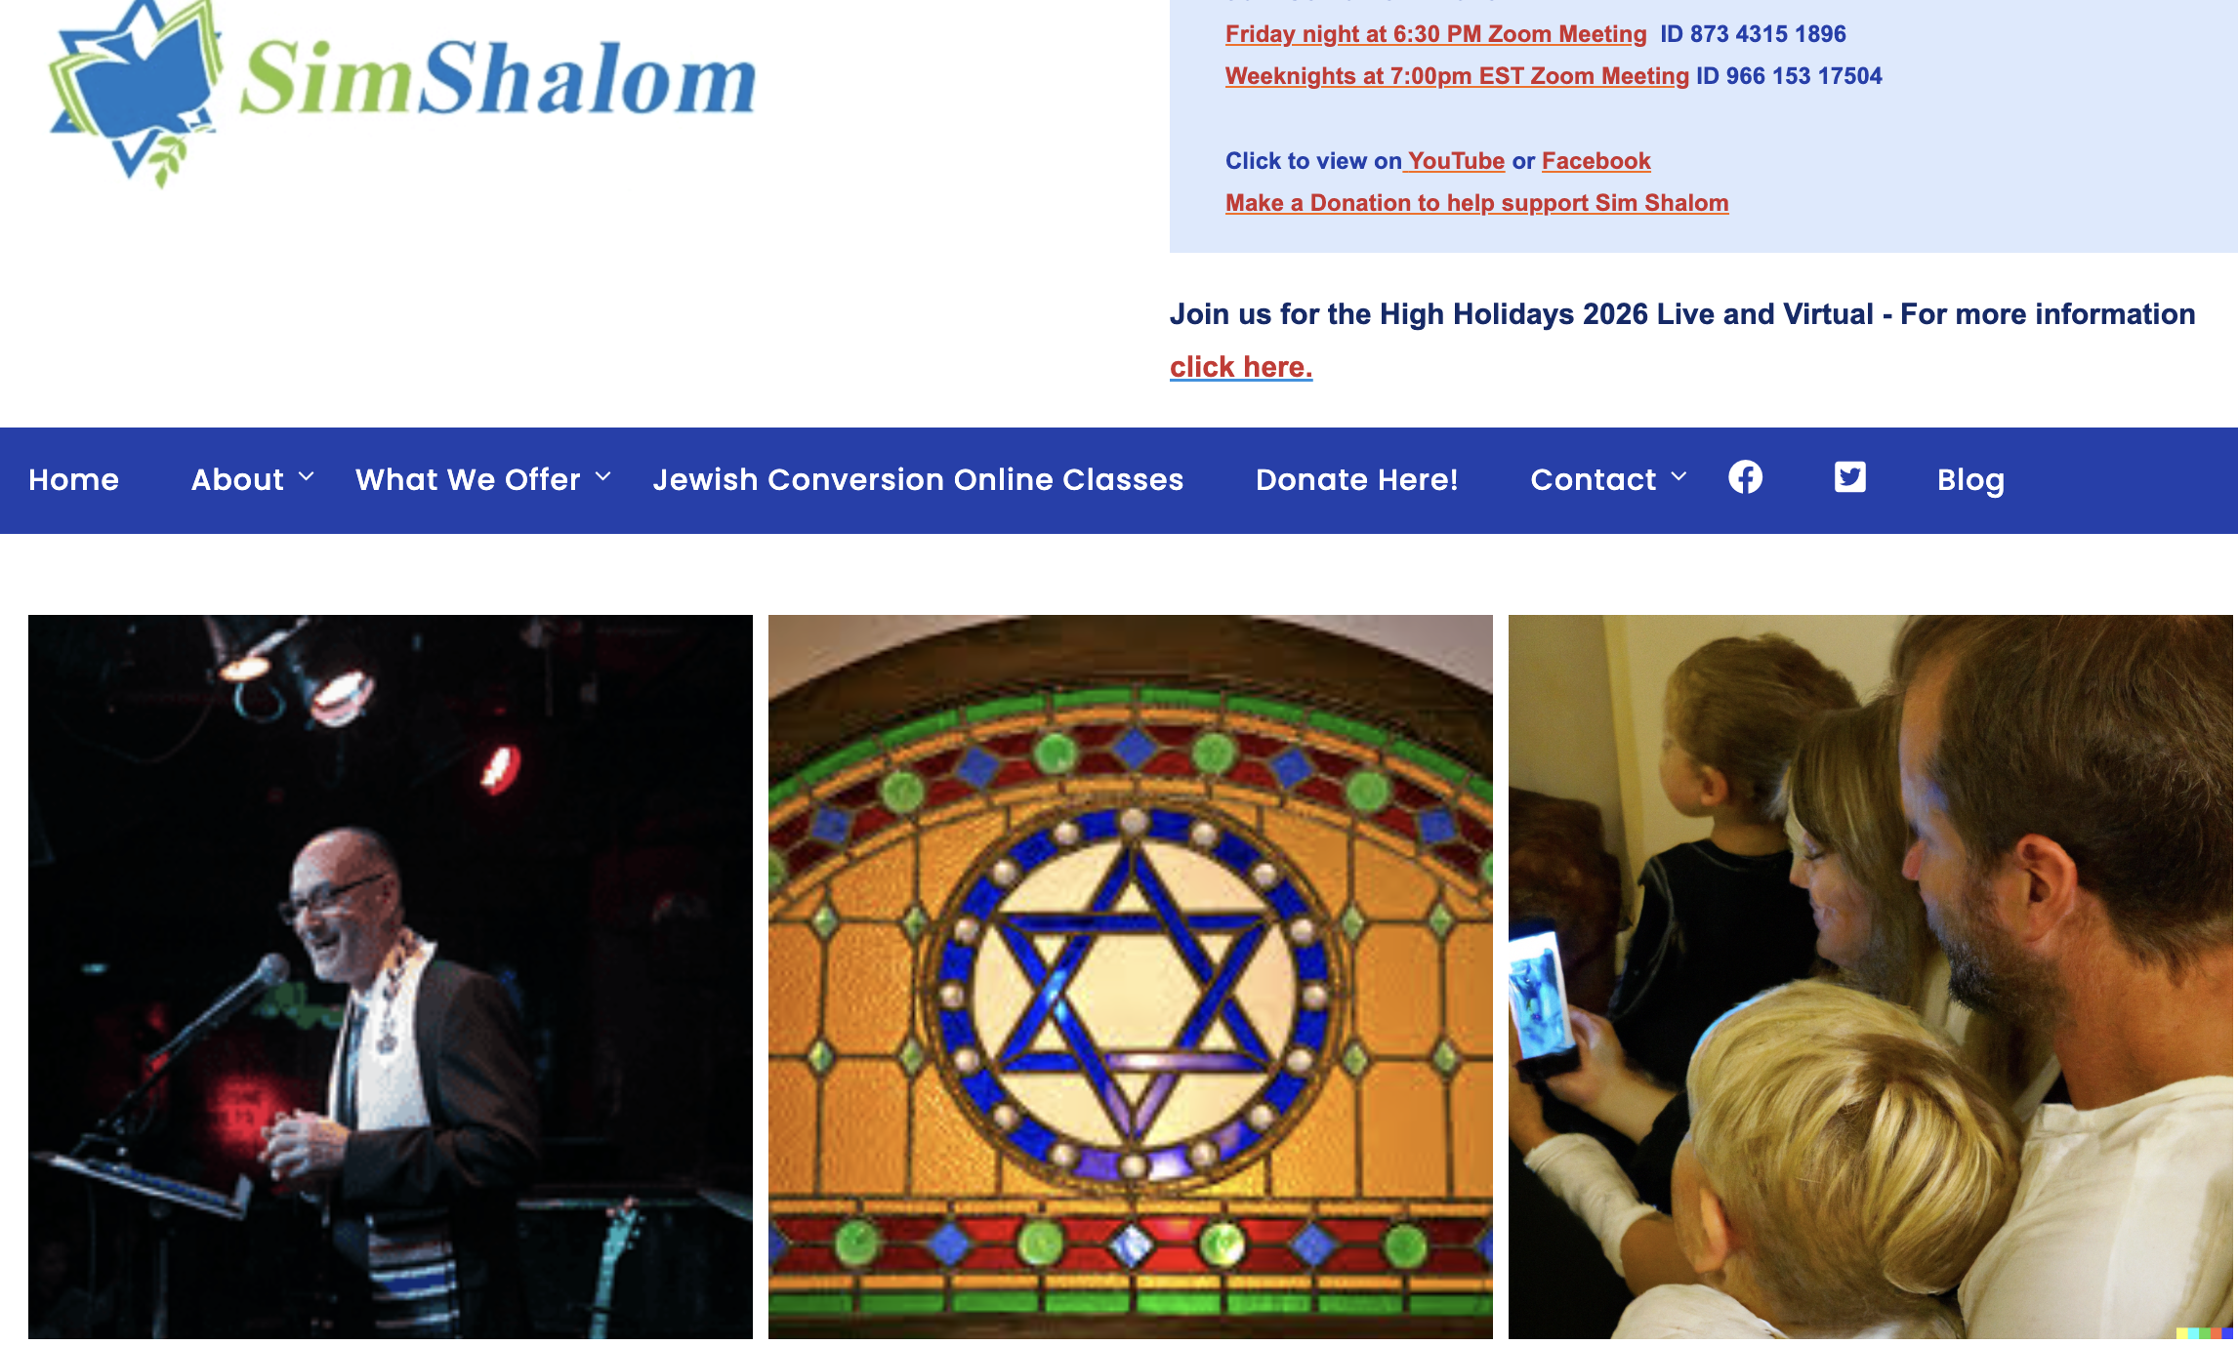

Slide 61


Slide 62
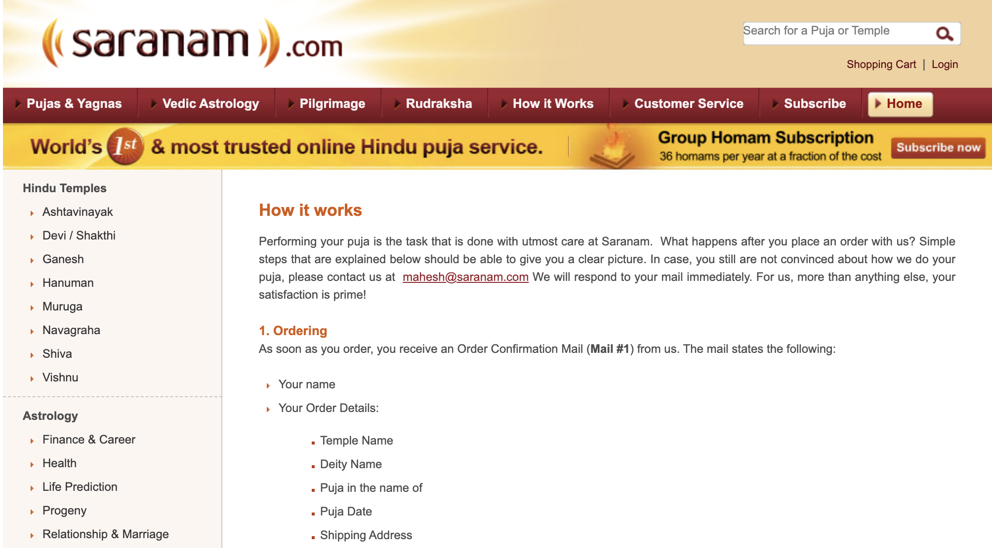
This seems to solve many problems at once. Those who live too far away from a temple can have easier access to it, while simultaneously those who are too busy to go to a temple nearby can have a hassle-free way of fulfilling religious obligations.

Slide 63

Conclusion
There is inherent complexity in the relationship between religion, technology, and identity in the current context of digital globalization
Online is not the same as in-person
Online vastly increases access – in multiple dimensions
Online religion is less costly to sustain than buildings and travel
We have a great deal of work to do in optimizing, improving and reimagining liberal religion in digital spaces.

Slide 64
Your comments and questions MOST welcomed!
Terry Anderson
terrydanderson2@gmail.com

